Slide 1
File System Management
File System Implementations
Lecture 11

Slide 2
Overview
File System Implementation:
  File system layout
  Disk organization
Implementation details for:
  File Information
  Free Space Management
  Directory Structure
File System in Action
Disk I/O Scheduling

Slide 3
File System Implementation: Overview
File systems are stored on storage media:
  e.g. Hard disk, CD/DVD, SRAM etc
Concentrate on hard disk in this lecture
  Though the ideas are generally applicable
General Disk Structure:
  Can be treated as a 1-D array of logical blocks
  Logical block:
    Smallest accessible unit (Usually 512-bytes to 4KB)
  Logical block is mapped into disk sector(s)
    Layout of disk sector is hardware dependent

Slide 4





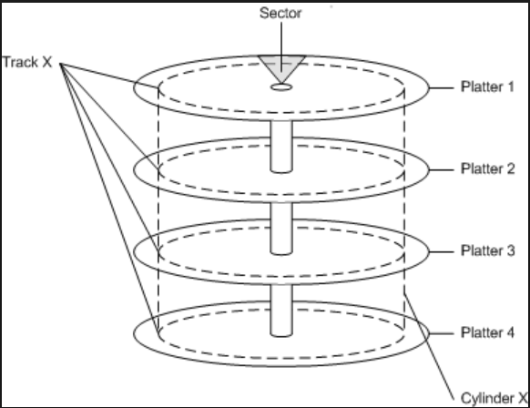
User ←→ OS ←→ Hardware: Views
….
file.txt
User
OS - FS
Storage

Slide 5
Disk Organization: Overview
Disk organization:
  Master Boot Record (MBR) at sector 0 with partition table
  Followed by one or more partitions
    Each partition can contains an independent file system
A file system generally contains:
  OS Boot-Up information
  Partition details:
    Total Number of blocks
    Number and location of free disk blocks
  Directory Structure
  Files Information
  Actual File Data

Slide 6
Generic Disk Organization: Illustration
Simple Boot Code
Partition Table
MBR
Partition
Partition
……
Partition
OS Boot Block
Partition Details
Directory Structure
Files Info
File Data
Information for all files are here
Data for all files are here

Slide 7
Implementing File
OS Boot Block
Partition Details
Directory Structure
Files Info
File Data
Notes:
Should be file data only?

Slide 8
File Implementation: Overview
Logical view of a file:
  A collection of logical blocks
When file size != multiple of logical blocks
  Last block may contain wasted space
  i.e. internal fragmentation
A good file implementation must:
  Keep track of the logical blocks
  Allow efficient access
  Disk space is utilized effectively
Basically focuses on how to allocate file data on disk

Slide 9
File Block Allocation 1: Contiguous
General Idea:
  Allocate consecutive disk blocks to a file
Pros:
  Simple to keep track:
    Each file only needs: Starting block number + Length
  Fast access (only need to seek to first block)
Cons:
  External Fragmentation
    Think of each file as a variable-size "partition"
    Over time, with file creation/deletion, disk can have many small "holes"
  File size need to be specified in advance

Slide 10
Contiguous Block Allocation
Directory
file size
count 2
tr 3
mail 6
list 4
f 2
start length
0 2
14 3
19 6
28 4
6 2
0
1
2
3
4
5
6
7
8
9
10
11
12
13
14
15
16
17
18
19
20
21
22
23
Disk Block
24
25
26
27
Block Number
28
29
30
31

Slide 11
File Block Allocation 2: Linked List
General Idea:
  Keep a linked list of disk blocks
  Each disk block stores:
    The next disk block number (i.e. act as pointer)
    Actual file data
  File information stores:
    First and last disk block number
Pros:
  Solve fragmentation problem
Cons:
  Random access in a file is very slow
  Part of disk block is used for pointer
  Less reliable (what if one of the pointers is incorrect?)

Slide 12
Linked List Allocation
file size
jeep 5
start
9
end
25
0
1
2
3
4
5
6
7
First Disk Block Number
8
9
10
11
12
13
14
15
Last Disk Block Number
16
17
18
19
20
21
22
23
Next Disk Block Number contains a special value to indicate the end of list
24
25
26
27
28
29
30
31

Slide 13
File Block Allocation 2: Linked List V2.0
General Idea:
  Move all the block pointers into a single table
    known as File Allocation Table (FAT)
    FAT is in memory at all time
  Simple yet efficient
    Used by MS-DOS
Pros:
  Faster Random Access
    The linked list traversal now takes place in memory
Cons:
  FAT keep tracks of all disk blocks in a partition
    Can be huge when disk is large
    Consume valuable memory space

Slide 14
FAT Allocation
file size
jeep 5
start
9
0
1
2
3
0
4
5
6
7
1
1
10
8
9
10
11
9
16
12
13
14
15
Disk Block Number used to index table
10
25
16
17
18
19
20
21
22
23
16
1
24
25
26
27
25
-1
28
29
30
31
n-1

Slide 15
File Block Allocation 3: Indexed Allocation
General Idea:
  Each file has an index block
    An array of disk block addresses
    IndexBlock[ N ] == N^{th} Block address
Pros:
  Lesser memory overhead
    Only index block of opened file needs to be in memory
  Fast direct access
Cons:
  Limited maximum file size
    Max number of blocks == Number of index block entries
  Index block overhead

Slide 16
Indexed Allocation
file
jeep
index block
19
0
1
2
3
4
5
6
7
8
9
10
11
9
16
1
10
25
-1
-1
-1
12
13
14
15
Disk Block used by this file (in order)
16
17
18
19
19
20
21
22
23
24
25
26
27
28
29
30
31

Slide 17
Indexed Block Allocation: Variation
Several schemes to:
  Allow larger file size
Linked scheme:
  Keep a linked list of index blocks
  Each index block contains the pointer to next index block
Multilevel index:
  Similar idea as multi-level paging
  First level index block points to a number of second level index blocks
    Each second level index blocks point to actual disk block
  Can be generalized to any number of levels

Slide 18
Indexed Block Allocation: Variation (cont)
Combined scheme:
  Combination of direct indexing and multi-level index scheme
  Example: Unix I-node has:
    12 direct pointers that point to disk block directly
    1 single indirect block
      which contains a number of direct pointers
    1 double indirect block
      which points to a number of single indirect blocks
    1 triple indirect block
      which points to a number of double indirect blocks
    A combination of efficiency (for small file) and flexibility (still allow large file)

Slide 19
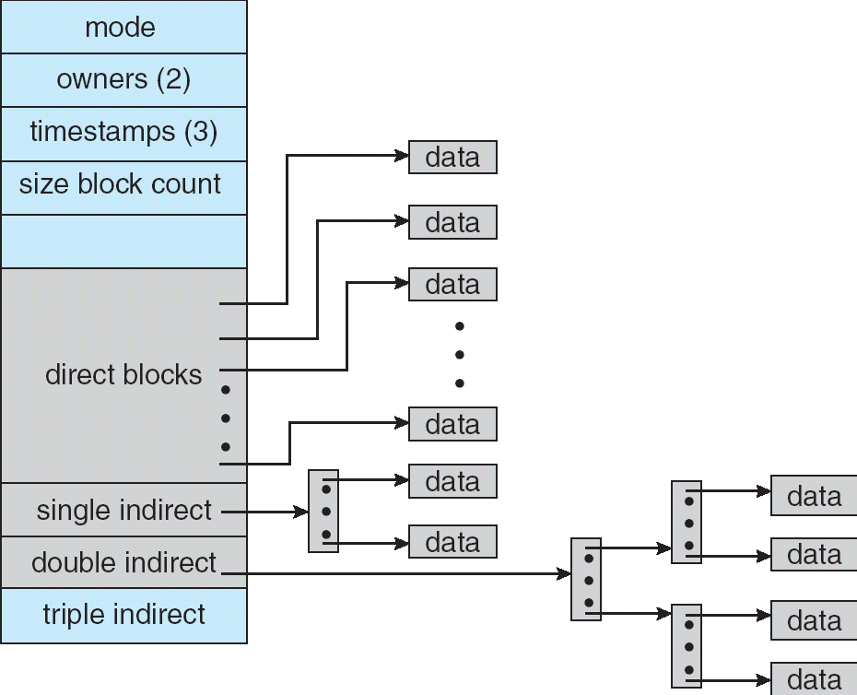
Unix Indexed Node: Illustration
Image taken from "Operating System Concepts" 7th Edition by Silberschatz, Galvin and Gagne

Slide 20
Free Space Management
OS Boot Block
Partition Details
Directory Structure
Files Info
File Data

Slide 21
Free Space Management: Overview
To perform file allocation:
  Need to know which disk block is free
  i.e. maintain a free space list
Free space management:
  Maintain free space information
  Allocate:
    Remove free disk block from free space list
    Needed when file is created or enlarged (appended)
  Free:
    Add free disk block to free space list
    Needed when file is deleted or truncated

Slide 22
Free Space Management: Bitmap
Each disk block is represented by 1 bit
  E.g. 1 == free, 0 == occupied
Example:
0 1 0 1 1 1 0 0 1 0 1 1 ......
    Occupied Blocks = 0, 2, 6, 7, 9, …
    Free Blocks = 1, 3, 4, 5, 8, 10, 11, …
Pros:
  Provide a good set of manipulations
    E.g. can find the first free block, n-consecutive free blocks easily by bit level operation
Cons:
  Need to keep in memory for efficiency reason

Slide 23
Free Space Management: Linked List
Use a linked list of disk blocks:
  Each disk block contains:
    A number of free disk block numbers
    A pointer to the next free space disk block
Pros:
  Easy to locate free block
  Only the first pointer is needed in memory
    Though other blocks can be cached for efficiency
Cons:
  High overhead
    Can be mitigated by storing the free block list in free blocks!

Slide 24
Implementing Directory
OS Boot Block
Partition Details
Directory Structure
Files Info
File Data
Notes:
Should include Files Info

Slide 25
Directory Structure: Overview
The main tasks of a directory structure:
  Keep tracks of the files in a directory
    Possibly with the file metadata
  Map the file name to the file information
Remember:
  File must be opened before use
    Something like open( "data.txt" );
  The purpose of the open operation:
    Locate the file information using pathname + file name
Path name
  List of directory names traversed from root
  E.g. /dir2/dir3/data.txt

Slide 26
Directory Structure: Overview (cont)
Given a full path name:
  Need to recursively search the directories along the path to arrive at the file information
Example:
    Full path name: /dir2/dir3/data.txt
    Find "dir2" in directory "/"
      Stop if not found (or incorrect type)
    Find "dir3" in directory "dir2"
      Stop if not found (or incorrect type)
    Find "data.txt" in directory "dir3"
      Stop if not found (or incorrect type)
Sub-directory is usually stored as file entry with special type in a directory

Slide 27
Directory Implementation: Linear List
Directory consists of a list:
  Each entry represents a file:
    Store file name (minimum) and possibly other metadata
    Store file information or pointer to file information
Locate a file using list:
  Requires a linear search
    Inefficient for large directories and/or deep tree traversal
  Common solution:
    Use cache to remember the latest few searches
      User usually move up/down a path

Slide 28
Directory Implementation: Hash Table
Each directory contains a
  Hash table of size N
To locate a file by file name:
  File name is hashed into index K from 0 to N-1
  HashTable[K] is inspected to match file name
    Usually chained collision resolution is used
    i.e. file names with same hash value is chained together
      to form a linked list with list head at HashTable[ K ]
Pros:
  Fast lookup
Cons:
  Hash table has limited size
  Depends on good hash function

Slide 29
Directory Implementation: File Information
File information consists of:
  File name and other metadata
  Disk blocks information
    As discussed in the file allocation schemes earlier
Two common approaches:
Store everything in directory entry
  A simple scheme is to have a fixed size entry
    All files have the same amount of space for information
Store only file name and points to some data structure for other info

Slide 30
File System in Action
File locked and loaded!

Slide 31
File System in Action: Overview
Previous sections are on static information for a FS stored on media
At runtime, when user interacts with file:
  Run-time information is needed
  Maintained by OS in memory
[Recap] Common in-memory information:
  System-wide open-file table:
    Contain a copy of file information for each open file + other info
  Per-process open-file table:
    Contains pointer to system-wide table + other info
  Buffers for disk blocks read from/written to disk

Slide 32
Walkthrough on file operation: Create
Let us relook at the file operation
  With the newly covered details
To create a file /…/…/parent/F:
  Use full pathname to locate the parent directory
    Search for filename F to avoid duplicates
      If found, file creation terminates with error
    Search could be on the cached directory structure
  Use free space list to find free disk block(s)
    Depends on allocation scheme
  Add an entry to parent directory
    With relevant file information
    File name, disk block information etc

Slide 33
File Creation: Illustration
Create( filePath, …)
…
Directory Structure
Files Info
User Program
…
File Data
Directory Structure
(Can be cached in memory)
Secondary
Storage

Slide 34
Walkthrough on file operation: Open
Process P open file /…/…/…/F:
  Search system-wide table for existing entry E
    If found:
      Creates an entry in P's table to point to E
      Return a pointer to this entry
    If not found, continue to next step
  Use full pathname to locate file F
      If not found, open operation terminates with error
    When F is located, its file information is loaded into a new entry E in system-wide table
    Creates an entry in P's table to point to E
    Return a pointer to this entry
The returned pointer is used for further read/write operation

Slide 35
File Open: Improved Understanding
0
Directory Structure
Proc P PCB
…
…
Open( filePath, …)
0
1
Files Info
…
…
fd
File Data
File Descriptor
Table
E
Op.Type: …
File Info:
File Data:
…
…
Secondary
Storage
Open File Table

Slide 36
disk I/O Scheduling
(Not examinable)
I'm afraid you have to wait…..

Slide 37
Magnetic Disk in One Glance
Rotation
(Change Sector)
Seek
(Change Track)
Track
Disk Head
Sector

Slide 38
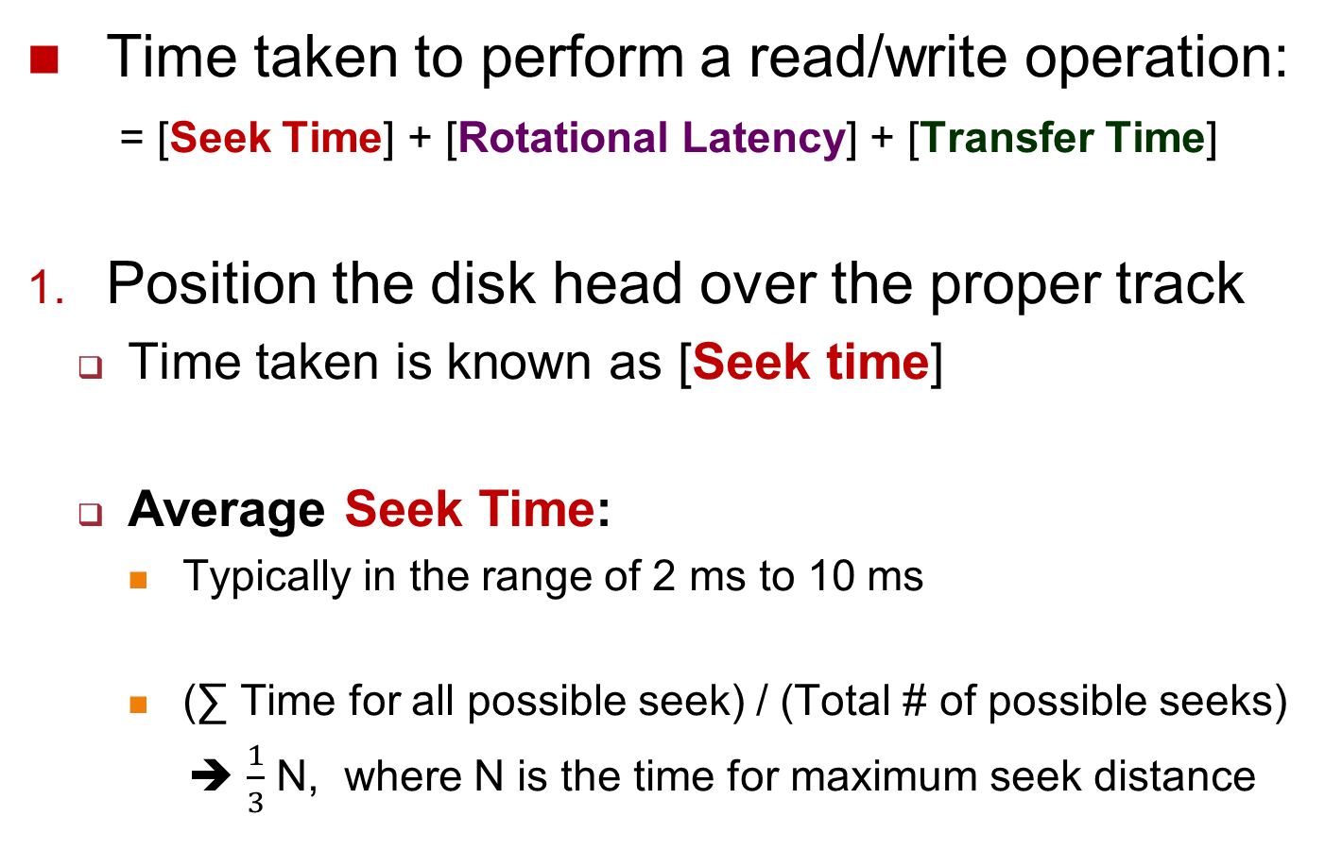
3-Stage of Read/Write Process (1/3)
Time taken to perform a read/write operation:
  = [Seek Time] + [Rotational Latency] + [Transfer Time]
Position the disk head over the proper track
  Time taken is known as [Seek time]
  Average Seek Time:
    Typically in the range of 2 ms to 10 ms
    (∑ Time for all possible seek) / (Total # of possible seeks)
    ➔ $\frac{1}{3}$ N, where N is the time for maximum seek distance

Slide 39
3-Stage of Read/Write Process (2/3)
Wait for the desired sector to rotate under the read/write head
  Time taken is known as [Rotational latency]
  Rotation speed: 4800 to 15000 rotations per minute (RPM)
  ➔ 12.5 ms to 4 ms per rotation respectively
  Average Rotational Latency:
    Assume desired data is halfway around the track
    ➔ 6.25 ms at 4800 RPM, 2 ms at 15000 RPM

Slide 40
3-Stage of Read/Write Process (3/3)
Transfer the sector(s)
  Time taken is known as [Transfer time]
  Transfer Time is a function of :
    Transfer size / Transfer Rate
      Transfer size: [X KB / Sector] x [ # of Sectors]
      Transfer rate: 70 to 125 MB / second
    E.g. If we read 2 consecutive sectors of 512 Bytes
      Transfer size = 512B x 2 = 1KB
      Assuming a transfer rate of 100MB/second
      Transfer time = 1KB / 100MB per second
      = 2¹⁰ / 100 x2²⁰ = 9.7µs
(1) + (2) is significantly more than (3)

Slide 41
Disk Scheduling: The Problem
Due to the significant seek and rotational latency, OS should schedule the disk I/O requests
  With the intention of reducing overall waiting time
  As rotational latency is hard to mitigate, we focus on reducing the seeking time
Consider the following disk I/O requests indicated by only the track number:
  13, 14, 2, 18, 17, 21, 15
  Use the following algorithms to schedule these I/O requests

Slide 42
Disk Scheduling: Algorithms
A few obvious candidates:
  FCFS
  SSF (Shortest Seek First)
    "SJF" modified for the disk context
The SCAN family (aka Elevator):
  Bi-Direction [Innermost ←→ Outermost] (SCAN)
  1-Direction [Outermost→ Innermost] (C-SCAN)
  Very intuitive: Imagine the tracks are floors in a building, and the disk head is the elevator servicing the floors (Figure out the algorithm before lecture ☺)

Slide 43
FCFS: Disk Head Movement
Request: [13, 14, 2, 18, 17, 21, 15]

Slide 44
SSF: Disk Head Movement
Request: [13, 14, 2, 18, 17, 21, 15]

Slide 45
Summary
Covered implementation details for file system
  File Information
    Allocation schemes
  Free Space management
  Directory Structure
Relook at file operations from the OS viewpoint
Discussed OS responsibility in I/O scheduling

